Slide 1
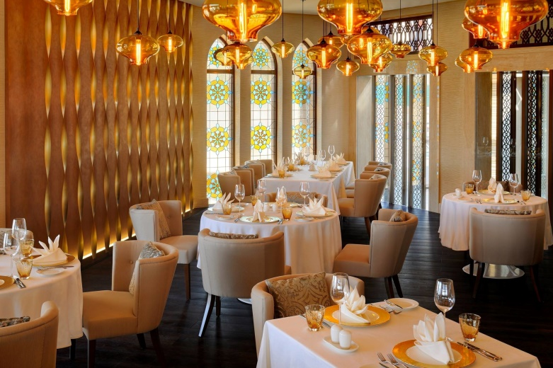
TEAM 2 PROJECT:RESTAURANT MANAGEMENT SYSTEM
TEAM MEMBERS: ASHMITHA SUMARAJ
JERINA G
G JOUSHA
PRAVEEN S
RAMESH P
SUJITH P S
SUJAN G
SANJAY S

Slide 2
AGENDA
INTRODUCTTION TO OUR PROJECT.
OBJECTIVES AND AIMS OF OUR PROJECT
WHAT IS RMS AND HOW DOES IT WORK?
WORKFLOW OF RMS.
SOFTWARE AND HARDWARE USED TP DEVELOP OUR PROJECT.
WHAT ARE THE MAIN FEATURES OF THE PROJECT: DATABASE USED, FRONT END DEVELOPER, UI DEVELOPER, BACKEND(PROGRAMMING PALTFORM).

Slide 3
INTRODUCTION
Restaurant Management System(RMS) is a type of system where a person can dive in and just book their items on spot or even book food online also allowing to book a party hall and menu as per their choice pre hand.
Our project works on all those aspects which satisfies the customer needs for a RMS.

Slide 4
Objective and aim of our project.
Objective:
To satisfy customers needs to allow a user to login in through their hotel booking app account to order food online, book a private hall or dining rooms pre hand and even dive in to taste the food themselves to avoid advertisement catch(expectation v/s reality).
AIM:
Our project fulfills the objectives that are placed by the customer and even enhance their pre-requisites to outlet the project in future view point.

Slide 5
What is RMS?
Restaurant management refers to managing day-to-day operations within a restaurant or similar setting. It encompasses various tasks and responsibilities, from overseeing company finances and facilitating business growth to overseeing marketing, managing the workforce, and delivering a great customer experience.
A restaurant management system is a type of software that has been specifically designed for use within the restaurant industry. Also known as restaurant management software, such solutions are intended to assist leaders and others in carrying out the most critical managerial tasks.
A system of this type may be a comprehensive all-in-one solution, including elements of a point-of-sale system, such as payment processing, with more complex back-end features, such as workforce management, inventory management, and a booking or reservations system. However, some restaurant management systems focus on specific areas.

Slide 6
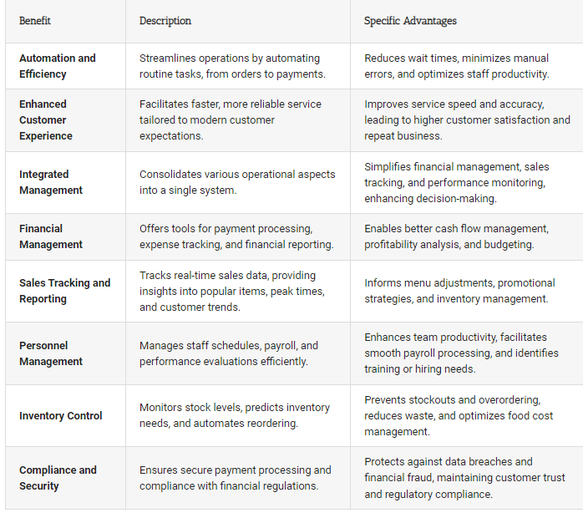
Benefits of RMS:

Slide 7
HOW DOES RMS WORK?
Order Management:
Menu Setup: The system allows the restaurant to input and update its menu, including item names, descriptions, prices, and images.
Order Placement: Customers can place orders through various channels such as in-house tablets, mobile apps, or websites integrated with the RMS.
Point of Sale (POS):
Order Processing: The RMS captures and processes orders, sending them to the kitchen or designated preparation areas.
Payment Processing: Handles various payment methods, including cash, credit/debit cards, and digital wallets.
Inventory Management:
Stock Tracking: Helps manage and track inventory levels of ingredients and supplies in real-time.
Automatic Reordering: Sends alerts or automatically generates purchase orders when stock levels fall below a predefined threshold.
Employee Management:
Access Control: Assigns different access levels to employees based on their roles (chef, cashier, manager, etc.).

Slide 8
Table Management:
Reservation System: Allows customers to make reservations, and staff to manage and allocate tables accordingly.
Table Status: Displays the status of tables (occupied, reserved, available) for efficient seating.
Reporting and Analytics:
Sales Reports: Provides insights into daily, weekly, and monthly sales, helping with decision-making and business strategy.
Inventory Reports: Tracks usage, waste, and costs associated with ingredients.
Customer Relationship Management (CRM):
Customer Database: Stores customer information for loyalty programs, targeted marketing, and personalized services.
Feedback Management: Collects and manages customer feedback for service improvement.
Integration with External Platforms:
Payment Gateways: Integrates with payment processing systems to facilitate seamless and secure transactions.
Online Ordering Platforms: Connects with third-party delivery and online ordering platforms if the restaurant offers these services.
Security:
Data Security: Ensures the security of sensitive customer and business data.
User Authentication: Requires secure login credentials for authorized access.

Slide 9
Key features of RMS:
Cloud based: Allows restaurants to manage information online and maintain a back end processing if an information loss happens.
Reporting and analytics: Reporting on the work from day to day basis becomes easy, rather than reporting each topic individually or through human resource management.
Customer Relationship Management(CRM): Helps customers to review their views and experiences and allowing restaurants to improve their working and other key aspects.
Feed back and review management: This helps to manage reviews online and get feedbacks and customer reviews through various tools.
Mobile Application: Allowing users to easy access to the system.
Security: This allows security of customers personal information and user authentication to sensitive data.

Slide 10
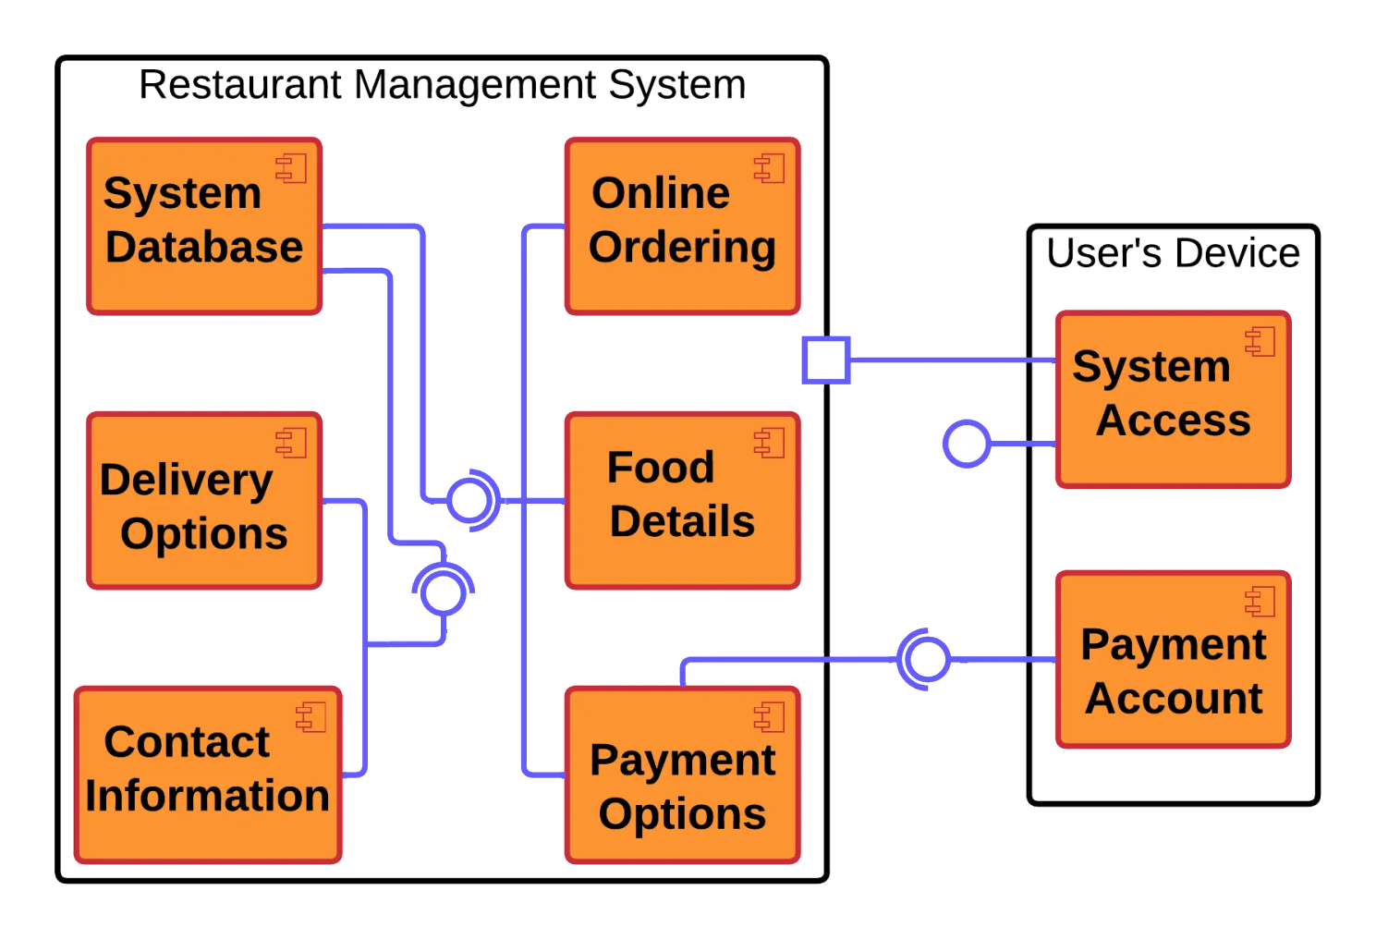
Work Flow of RMS:

Slide 11

Features included in our project.
Data-Base: MySQL
A database of Restaurant Management System has been created to read essential data that is to be inserted to develop the software application to perform the pre-requisites requested by the client(login page, to maintain users data, admin data and different sets of information).

Slide 12

Frontend Developer
HTML(VISUAL STUDIO):
Visual studio is a lightweight and highly customizable code editor with excellent support for JavaScript, HTML, and CSS.
HTML provides the basic building blocks for creating the structure of a webpage, defining elements such as headings, paragraphs, lists, links, images, and more.
Both of the software’s embedded together enables user appearance and applicability of code and web page application to be simple and appealing.

Slide 13

UI APPEARENCE
HTML(VISUAL STUDIO) AND EDGE:
Web page development has been done using the visual studio application with various HTML tags to create user appearance website page to link the backend process to perform all the operations requested by the user.

Slide 14
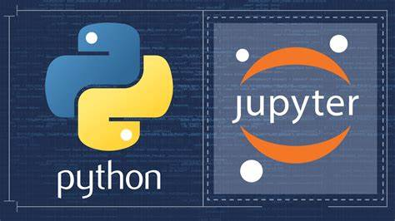
Backend( Programming Language used) and the website used to do programming.
Programming Language used: PYTHON
Python is the most widely used programming language. It is easy to implement and easy to understand. The implementation of the project can be done in easy way using python.
Website used to do programming: JUPYTER LAB
The python coding can be done easily using many platforms such as : VISUAL STUDIO, PYCHRAM, SPYDER, etc., but it is equally easy to do using JUPYTER. It includes integration of HTML CODE along with Python coding to add background image, backend process, form creation, etc.

Slide 15
SUMMARY
Our projects explores all the aspects of RESTAURANT MANAGEENT or THE HOTEL MANAGEMENT SYSTEM including taking orders, ordering food online also making pre hand table reservations.
The system also allows choosing menu in prior and review writing to improve the performance of the application or the project.

Slide 16


